Slide 1

Technical Seminar Presentation(Preliminary/Final) on “Holographic Memory”
Student:
Nitheesh Shetty
1RN19CS091
Guide:
Mrs.Yashasvi B N
Asst. Prof. Dept. of CSE, RNSIT
Department of Computer Science and Engineering
RNS INSTITUTE OF TECHNOLOGY
2022-23

Slide 2
CONTENTS
INTRODUCTION
Problem Statement
Existing System and Limitations
LITERATURE SURVEY
HOLOGRAPHIC SYSTEM
ESSENTIAL REQUIREMENTS
INFORMATION STORING IN HOLOGRAM DATA
INFORMATION RETRIEVAL FROM HOLOGRAM DATA
7. WORKING
8. CONCLUSION
Conclusion
Future work
9. REFERENCES

Slide 3
ABSTRACT
Holographic data storage is a viable alternative to magnetic disk
data storage.
Holographic memory is a technology that uses a three dimensional
medium to store data
Holographic data storage systems are very close to becoming economically feasible
Holographic memory lies between main memory and magnetic disk in regards to data access times, data transfer rates, and data storage density

Slide 4
INTRODUCTION
Holographic Memory came into existence to provide service of high data volume devices & to increase their data transfer rate for processing by ultra speed microprocessor.
It is a storage device which records binary information into one of holograms, then produces photo chromic media by laser beams.

Slide 5
EXISTING SYSTEM
A magnetic Disk is a type of secondary memory that is a flat disc covered with a magnetic coating to hold information.
Magnetic disks are less expensive than RAM and can store large amounts of data, but the data access rate is slower than main memory .

Slide 6
EXISTING SYSTEM V/S HOLOGRAPHIC MEMORY
Storage Medium
Access Time
Data Transfer Rate
Storage Capacity
Holographic Memory
2.4 μs
10 GB/s
400 Mbits/cm²
Main Memory (RAM)
10 – 40 ns
5 MB/s
4.0 Mbits/cm²
Magnetic Disk
8.3 ms
5 – 20 MB/s
100 Mbits/cm2

Slide 7
LITERATURE SURVEY
“Holographic data storage” by D. Psaltis , G.W. Bur which includes An alternative approach for next-generation memories is to store data in three dimensions.
“Recent Advantages in Holographic Data Storage” by Lambertus Hesselink , Jeffrey P. Wilde .
“Improvements of holographic data storage technology” Huang, Zhen , Wang, Zhengzi, Cao, Guoqiang, Hou, Yibing which includes Holographic data storage has many advantages, which makes it become one of the most hopeful next-generation data storage techniques.
“Theoretical Study of a Surface Collinear Holographic Memory” by Soki Hirayama, Ryushi Fujimura, Shinsuke Umegaki, Tsutomu Shimura.

Slide 8
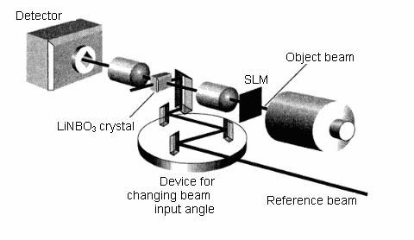
HOLOGRAPHIC SYSTEM

Slide 9
ESSENTIAL REQUIREMENTS
Blue-green argon laser
Beam splitters to split laser beam
Mirrors to direct the laser beams
LCD panel (spatial light modulator)
Lenses to focus the laser beams
Lithium-niobate crystal or photopolymer
Charge-coupled device (CCD) camera

Slide 10
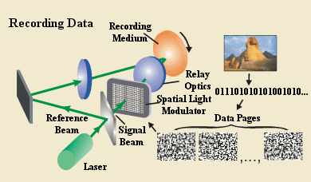
INFORMATION STORING IN HOLOGRAPHIC DATA

Slide 11
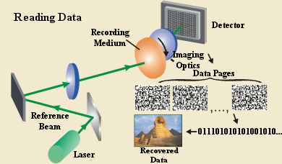
INFORMATION RETRIEVED FROM HOLOGRAPHIC DATA

Slide 12
WORKING
Let us consider a device assembly in which a beam of cyan argon laser is divided into two components - a reference and an object beam.
The object beam undergoes defocusing in order it could entirely illumine the SLM which is an LCD panel where a data page is displayed in the form of a matrix consisting of light and dark pixels.
The both beams go into the light-sensitive crystal where they interact.
So we get an interference pattern which serve a base for a hologram and is recorded as a set of variations of the refractive exponent and the reflection factor inside this crystal

Slide 13
CONCLUSION
ADVANTAGES
High storage density
Less data access time
High data transfer rate
Economically feasible
DISADVANTAGES
Recording rate and pixel size
Laser output power
Sensetivity of recording material

Slide 14
FUTURE WORK
Today holographic memory is very close to becoming a reality. The basic theory behind it has been shown to be reliable and has been implemented in numerous experiments.
For holographic memory to truly become the next revolution in data storage, data transfer rates must be improved, hologram decay must become negligible, and hologram recording time must be reduced.
Then it will be economical for holographic memories to be produced for mass consumption.

Slide 15
REFERENCES
[1] Staebler D L, Burke W J, Phillips W, Amodei JJ “Multiple storage and erasure of fixed holograms” in Fe-doped LiNbO3. Applied Physics Letters, 1975, 26(4): 182–184 .
[2] G. Deepika “Holographic Versatile Disc” with high data transfer rate: its application to an audio response memory. Applied Optics, 1980, 19(6): 944–951 .
[3] G. Burr, H. Coufa “High-density and high-capacity holographic data storage”, on Optical Information Technology, Vol. 10,No. 1, IBM Almaden Research Center, Jan-March 2021.
[4] http://www.akoniaholographics.com/holographic-data
[5] https://www.computerworld.com/article/2486820/read-this-before-you-buy-another-hard-drive.html

Slide 16
SUGGESTIONS….!

Slide 17
THANK YOU!!!

